Slide 1

DATA SCIENCE
Presented by:
1.Pratiksingh Rajeshsingh Thakur(2019BCS133)
2.Jayesh Raju Akot(2019BCS137)

Slide 2
CONTENTS
TOPIC | PAGE NO.
1.INTRODUCTION | 3
2.COMPONENTS OF DATA SCIENCE | 4
3.PROBLEM STATEMENT | 5
4.SOLUTIONS | 6
5.CONCLUSION | 10
6.REFERENCES | 11

Slide 3
Data Science
What is Data?
Data plays a vital role in the development of various artificial intelligence projects. Data acts as the fuel for various machine learning applications. Hence data is very crucial ingredient of any modern day application.
What is Data Science?
Data science is the domain of study that deals with vast volumes of data using modern tools and techniques to find unseen patterns, derive meaningful information, and make business decisions.

Slide 4
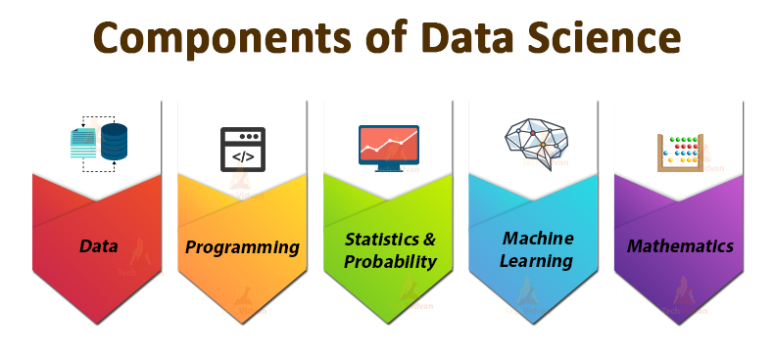
Data science is a very vast domain in itself. Since Data Science is very vast there a various problems associated with data science. These problems create hindrance while modeling data and extracting patterns from the data, and at many other stages while creating any data science application. Some of the problems associated with Data Science are :
Data Preparation
Multiple Data Sources
Data Security
Understanding the business problem etc.

Slide 5
Problem Statement:
DATA SECURITY
As organizations transition into cloud data management, cyberattacks have become increasingly common. This has caused major problem –
Confidential data is becoming vulnerable.

Slide 6
To counter this problem we have came up two effective solutions to protect our sensitive data.

Slide 7
Backup and Recovery:
A backup and recovery solution helps organizations protect themselves in case data is deleted or destroyed. All critical business assets should be duplicated periodically to provide redundancy so that if there is a server failure, accidental deletion or malicious damage from ransomware or other attacks, you can restore your data quickly.
For best results, backup copies are made on a consistent, regular basis to minimize the amount data lost between backups. The more time passes between backup copies, the more potential for data loss when recovering from a backup. Retaining multiple copies of data provides the insurance and flexibility to restore to a point in time not affected by data corruption or malicious attacks.

Slide 8
2.Data Encryption:
Data encryption is a security method where information is encoded and can only be accessed or decrypted by a user with the correct encryption key. Encrypted data, also known as ciphertext, appears scrambled or unreadable to a person or entity accessing without permission.
How Data Encryption works:
Modern data encryption is a form of cryptography, an ancient technique of hiding information by substituting one character for another. The word ‘encryption’ is a blend of English and Greek that means “in hidden” or, more loosely, “in hiding.”. Encryption works by means of a complex mathematical algorithm known as a data encryption cipher. Encryption uses an algorithm to scramble, or encrypt, data and then uses a key for the receiving party to unscramble, or decrypt, the information. The message contained in an encrypted message is referred to as plaintext. In its encrypted, unreadable form it is referred to as ciphertext. The ciphertext is unreadable. The phrase, “Hi, how are you?” might encrypt into a ciphertext that reads, “8363, 5017, 11884, 9546.” To get back to “Hi, how are you” requires a process of decryption.
Decoding information from ciphertext to plaintext is called decryption and involves the same algorithmic “key” that was used to encrypt the data.

Slide 9
Common Data Encryption Methods
The two most widely used methods for data encryption are public key, also known as asymmetric encryption and private key, or symmetric encryption. Both rely on key pairs, but they differ in the way the sending and receiving parties share the keys and handle the encrypt/decrypt process.
Public Key Encryption :
With public key/asymmetric encryption, the sender uses a publicly known key to encrypt the data. The receiver has the private key that forms the other half of the public-private key pair. Using the private key, in combination with the public key, the receiver can decrypt the data.
2. Private Key Encryption:
Private key/Symmetric encryption uses a single, private key for encryption and decryption. It is a faster method than asymmetric encryption and is best used by individuals or within closed systems, because using symmetric methods with multiple users in open systems, such as over a network, requires the transmission of the key and creates an opportunity for theft.

Slide 10
Conclusion:
Data Science is a very dynamic domain, with various applications and concepts. Data is a very crucial part of data science and the entire accuracy and precision of a data science application depends on the purity of data.
Data Security plays a vital role in the concern of accuracy of data-driven application. This creates a big concern with the security of data. There are various solutions proposed by the developer for the purpose. The common features of the data plays a vital role in deciding the data security policy. Data Security enhances the abilities of the project. There are various Data Security policies which can be efficiently used to ensure the security of data and maintain the accuracy of the application.

Slide 11
References
https://www.simplilearn.com/tutorials/data-science-tutorial/what-is-data-science
https://acuvate.com/blog/challenges-faced-by-data-scientists/
https://cloudian.com/guides/data-protection/data-encryption/
https://medium.com/searchencrypt/what-is-encryption-how-does-it-work-e8f20e340537

Slide 12
THANK YOU!

